Slide 1
Inpatient Survey 2023: demographics
SE Performance Analysis Team
Presented by: Neil Jackson
Notes:
Standard title slide

Slide 2
Main question
Does the Inpatient Survey show poorer outcomes for particular demographic groups?
Notes:
Plain slide with subhead and bullets

Slide 3
Background
Survey of all acute trusts in England
>40 questions, responses from 0 (worst) to 10 (best)
We have mean score for each question for each trust
We also have breakdown of respondents in each trust by various demographic characteristics
However we don’t have responses by characteristic
This makes it challenging to directly analyse the results by characteristic
Notes:
Plain slide with subhead and bullets

Slide 4
Approach
I used a statistical methodology called “mixed effects regression”
This allows for an effect from both the demographic characteristic(s) in the model and the trust in question
It allows for the fact that scores for different questions in the same trust are likely to be correlated, regardless of demographics
Each question score then has four elements:
Fixed intercept (the score if all else was equal)
Effect of the demographic characteristic – proportional to the % in that trust with that characteristic
Effect of the trust
Error term (the variation not explained by the model)
Notes:
Plain slide with subhead and bullets

Slide 5
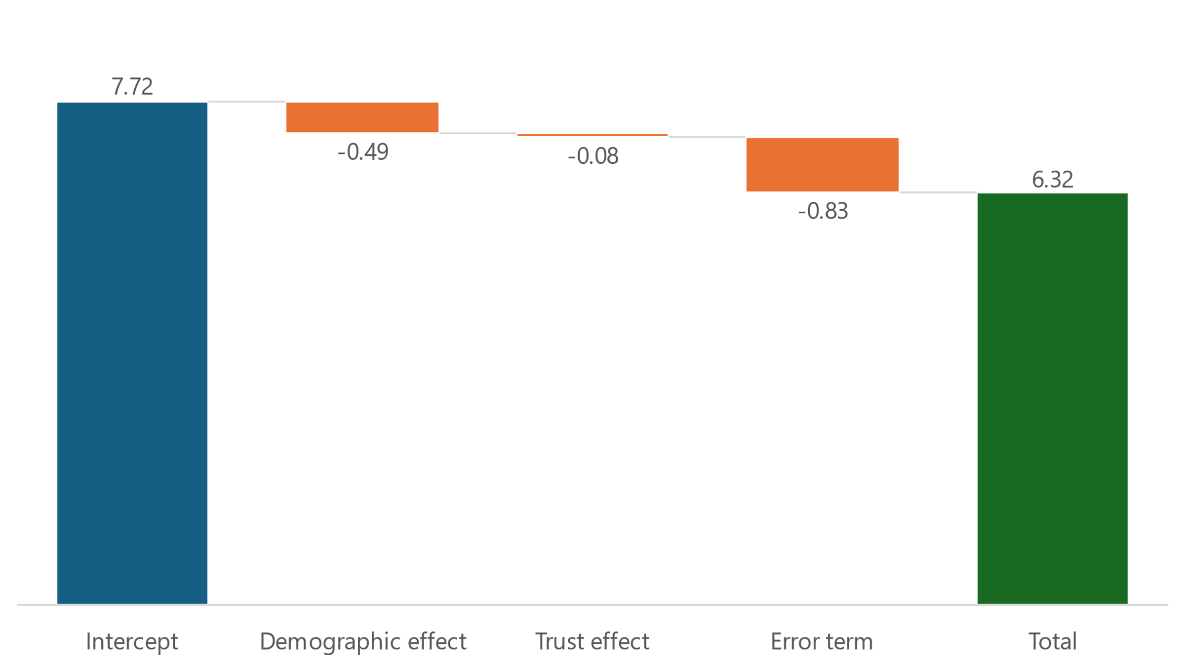
Example
Question 2 in trust XYZ has a mean score of 6.32. In this example we are using the proportion of respondents who are non-white
Fixed effect for non-white respondents, multiplied by % non-white in trust XYZ (-0.08 x 6.07)
Difference not explained by this model
The starting point:
score if everything else was zero
Effect for trust XYZ
Notes:
Plain slide with subhead and bullets

Slide 6
Findings
No model was found that explains more than 4% of the variation in the survey scores
This suggests that there is no strong association between the survey results and any of the demographic variables available
In particular, the trusts of most concern in the South East (Dartford & Gravesham, East Kent, Medway and Portsmouth) were consistently in the bottom 30 (out of 131) nationally when controlling for any demographic characteristic
The characteristic of most interest that was not available was deprivation. In particular, the fact that 3 of the 4 trusts of concern are in the Kent & Medway ICB area suggests that location may be a factor, but the data to investigate this is not readily available
Notes:
Plain slide with subhead and bullets

